Slide 1
Instrumentation
Tutorial 1
Topic: Measurement and Errors

Slide 2
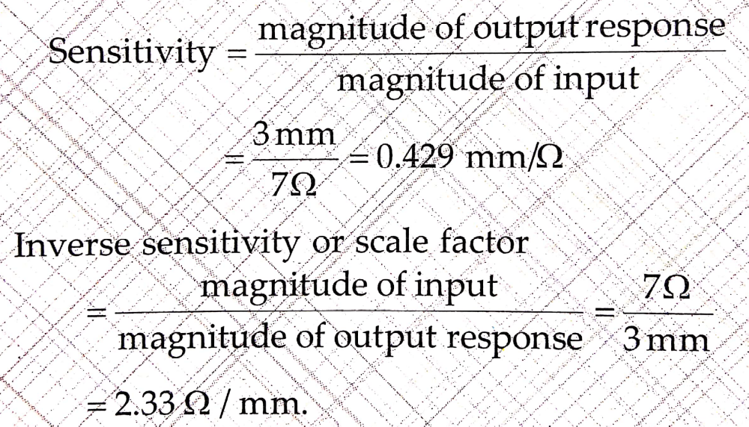
1. A wheatstone bridge requires a change of 7Ω in the unknown arm to produce a change of 3mm deflection of galvanometer. Determine the sensitivity and deflection factor(scale factor).
Sulution:

Slide 3
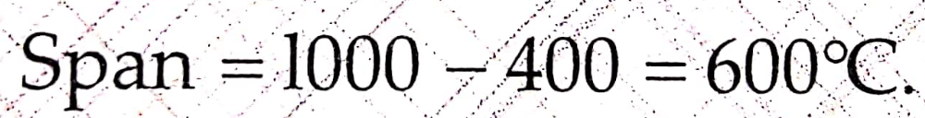
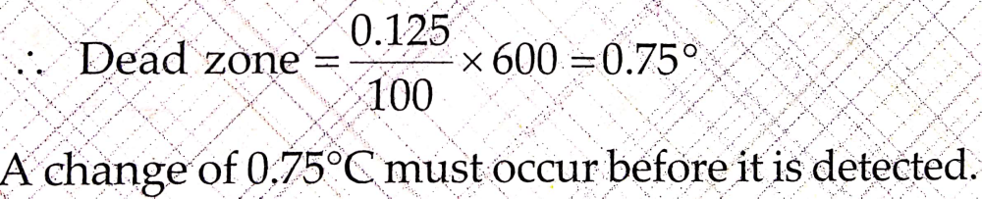
2. A dead zone in a certain pyrometer is 0.125% of span. The calibration is 400⁰C to 1000⁰C. What temperature change might occur before it is detected?
Solution:

Slide 4
3. A voltmeter can read out range from 0 to 200 counts. Determine the resolution of the instrument in volt when full scale reading is 1.21V.
Solution:
Total division= 200 divs.
FSR = 1.21V
Now,
200 divs = 1.21 V
1 div = 1.21/200 = 0.00605V
Therefore, the resolution of the instrument = 0.00605V.

Slide 5
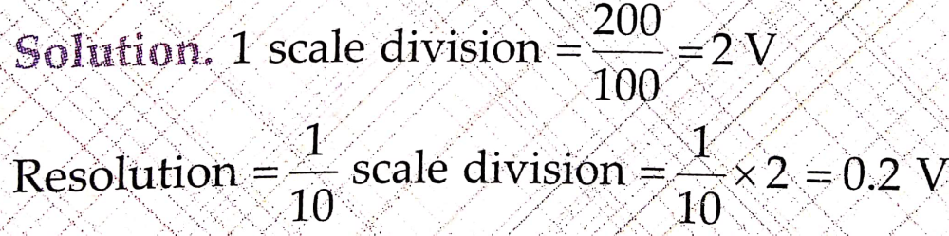
4. A moving coil voltmeter has a uniform scale with 100 divisions, the full scale reading is 200V and 1/10 of a scale division can be estimated with fair degree of certainty. Determine the resolution of the instrument in volt.

Slide 6
5. A voltmeter whose accuracy is 2% of the full scale reading is used on its 0 – 50V scale. The voltage measured by the meter is 15V and 42V. Calculate the possible percentage error of both readings. Comment upon your answer.
Solution:
Error = 2% of FSR = 0.02 × 50 = 1V
For 15V reading,
percent error = 1/15 × 100 = 6.67%
For 42V reading,
percent error = 1/42 × 100 = 2.38%
(Give comment)

Slide 7
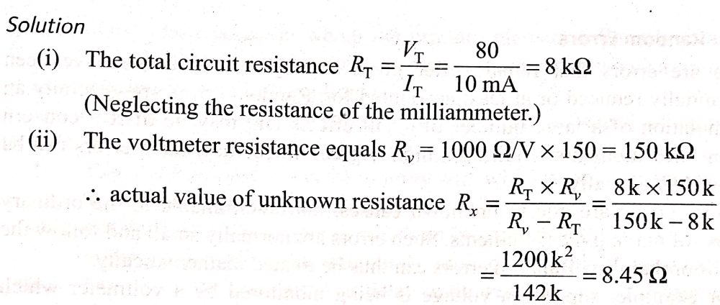
6. A voltmeter having a sensitivity of 1 kΩ/V is connected across an unknown resistance in series with a milliammeter reading 80 V on
150 V scale. When the milliammeter reads 10 mA, calculate the (i) Apparent resistance of the unknown resistance, (ii) Actual resistance of the unknown resistance, and (iii) Error due to the loading effect of the voltmeter.

Slide 8
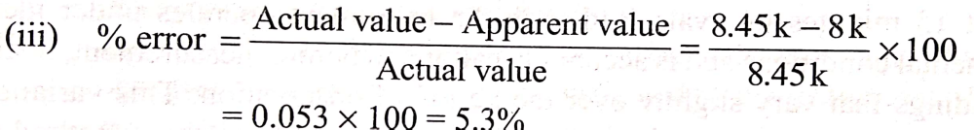
Continue…..

Slide 9
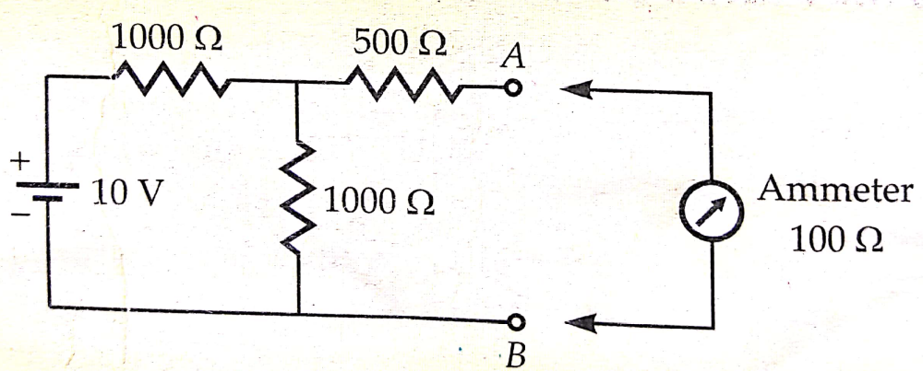
7. It is desired to measure the value of current in the 500Ω resistor as shown in the figure by connecting a 100Ω ammeter. Find:
The actual value of current
Measured value of current
Percentage error in measurement.

Slide 10
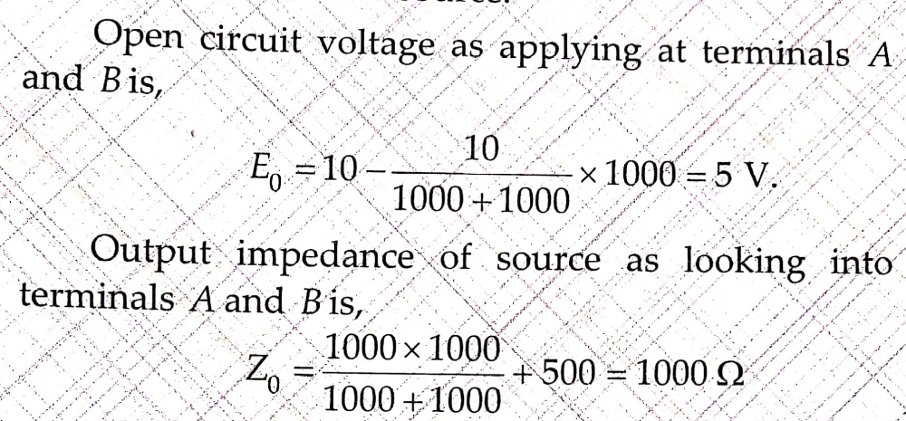
Solution:
a) Let us reduce the circuit in to equivalent Thevenin’s source:

Slide 11
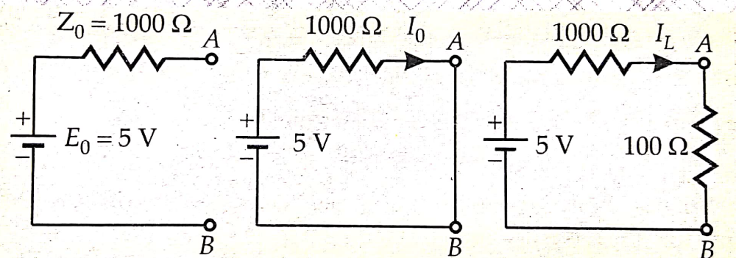
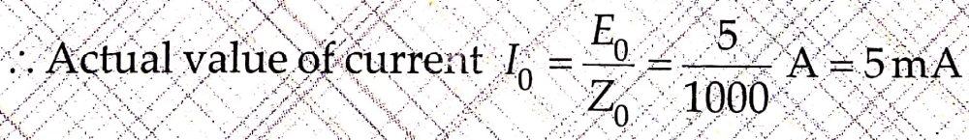
The Thevenin’s equivalent circuit is shown below:

Slide 12
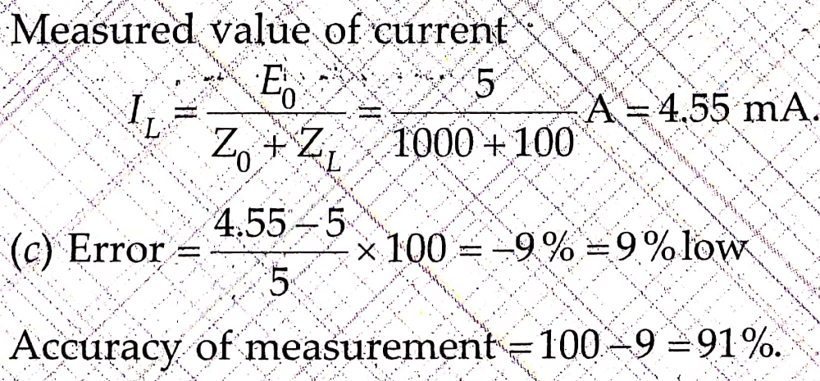
b) When the ammeter is introduced in to the ckt, the current is modified.

Slide 13
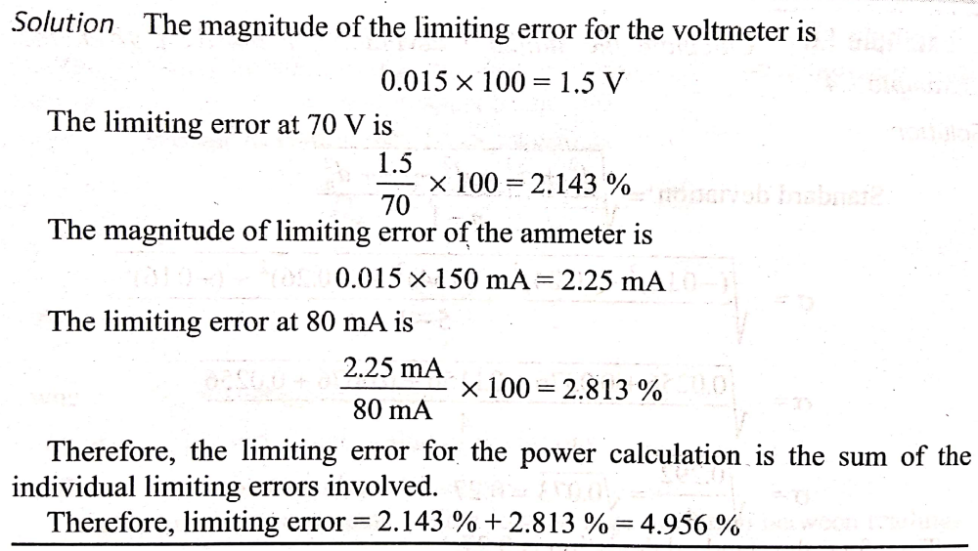
8. A voltmeter reading 70 V on its 100 V range and an ammeter reading 80 mA on its 150 mA range are used to determine the power dissipated in a resistor. Both these instruments are guaranteed to be accurate within
±1.5% at full scale defl ection. Determine the limiting error of the power.

Slide 14
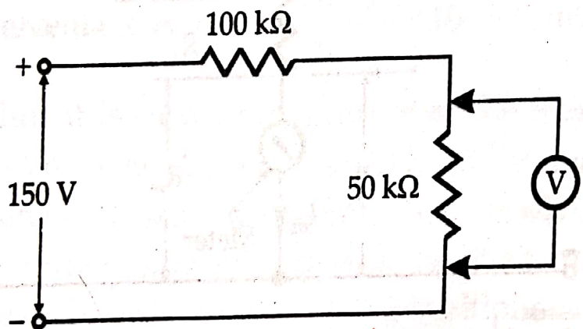
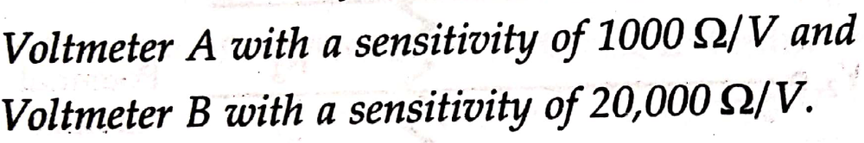
9. It is desired to measure voltage across 50Ω resistor in theb given circuit. Two voltmeters are available for this purpose.

Slide 15
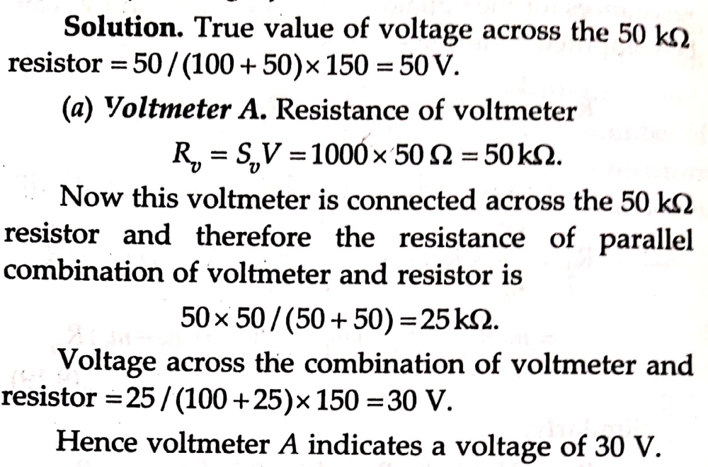
Solution:

Slide 16
Continue…

Slide 17
Continue…

